Slide 1
Railway Management System
Submitted By:
Nahida pervin Nisha 203002028
A.K.M Hasnine Mamud 203002004

Slide 2
Table of Content
Abstract
Introduction
ER Diagram(Conceptual Model)
List of Entities & Attributes
Schema Diagram
Create & Insert SQL Queries
End

Slide 3
Abstract
The Railway Management System facilitates the passengers to enquire about the trains available on the basis of source and destination, Booking and Cancellation of tickets, enquire about the status of the booked ticket, etc. The aim of case study is to design and develop a database maintaining the records of different trains, train status, and passengers. This project contains Introduction to the Railways management system. It is the computerized system of reserving the seats of train seats in advanced. It is mainly used for long route. On-line reservation has made the process for the reservation of seles very much easier than ever before.

Slide 4
Introduction
Database is an organized collection of data. The data is typically organized to model aspects of reality in a way that supports processes requiring information. A DBMS makes it possible for end users to create, read, update and delete data in a database. The DBMS essentially serves as an interface between the database and end users or application programs, ensuring that data is consistently organized and remains easily accessible. The DBMS manages three important things: the data, the database engine that allows data to be accessed, locked and modified and the database schema, which defines the database's logical structure. These three foundational elements help provide concurrency, security, data integrity and uniform administration procedures. The DBMS can offer both logical and physical data independence. That means it can protect users and applications from needing to know where data is stored or having to be concerned about changes to the physical structure of data.

Slide 5
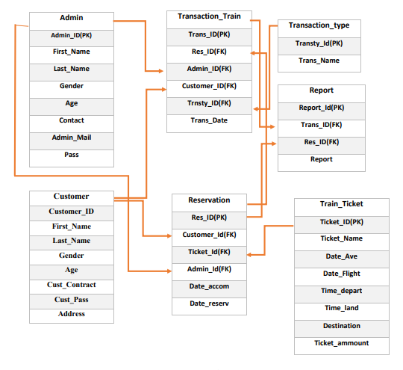
ER Diagram

Slide 6
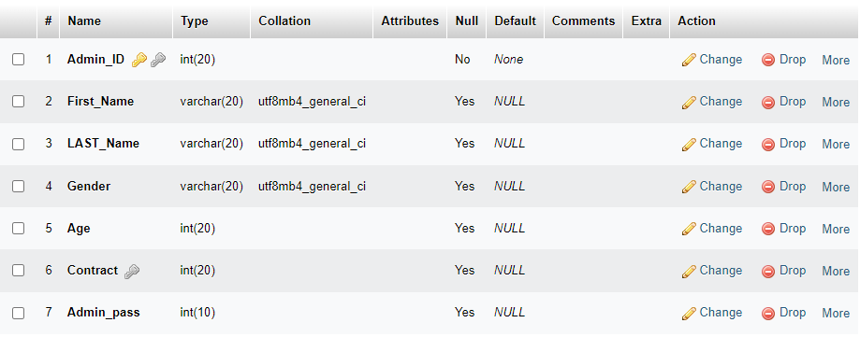
List of Entities & Attributes

Slide 7
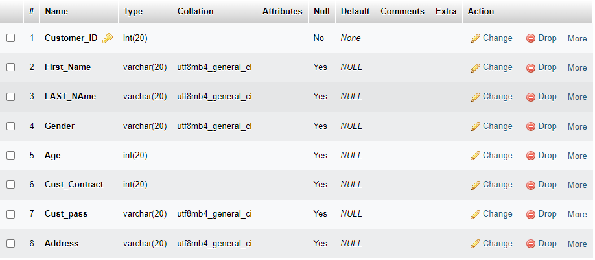
List of Entities & Attributes(cont.)

Slide 8
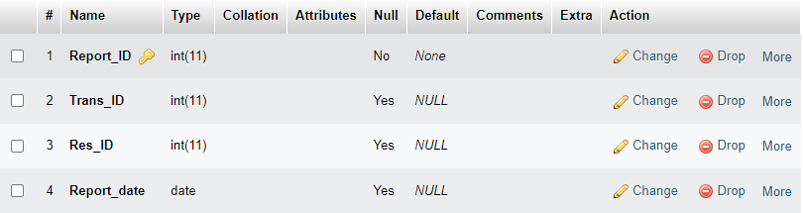
List of Entities & Attributes(cont.)

Slide 9
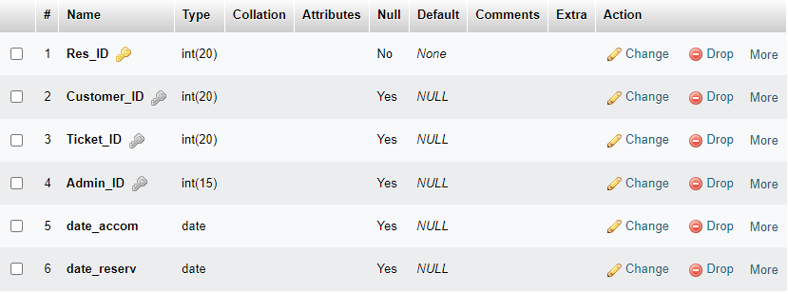
List of Entities & Attributes(cont.)

Slide 10
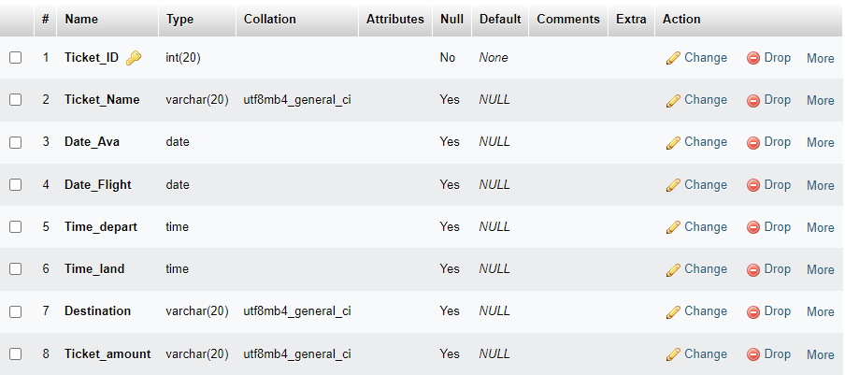
List of Entities & Attributes(cont.)

Slide 11
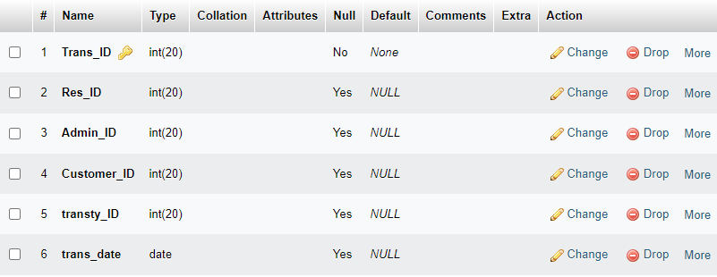
List of Entities & Attributes(cont.)

Slide 12
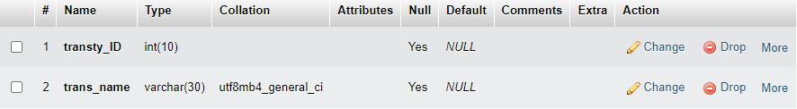
List of Entities & Attributes(cont.)

Slide 13
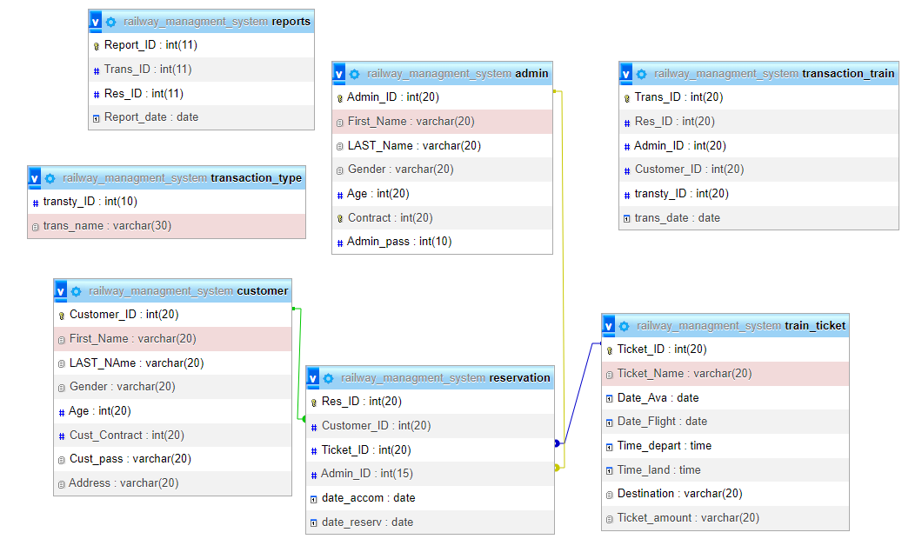
Schema Diagram

Slide 14

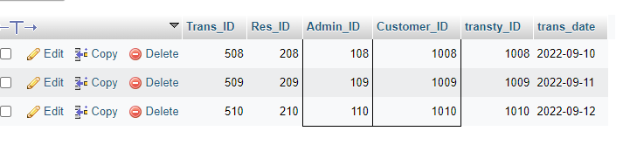
Create & Insert SQL Queries
SELECT train_ticket.Date_Ava,train_ticket.Ticket_ID,train_ticket.Time_depart,train_ticket.Time_land,train_ticket.Destination,train_ticket.Ticket_amount FROM train_ticket WHERE train_ticket.Ticket_Name = 'Salah’;
SELECT * FROM transaction_train WHERE Customer_ID <= 1010 AND Admin_ID > 107;

Slide 15



Create & Insert SQL Queries(cont.)
SELECT * FROM train_ticket WHERE train_ticket.Destination = 'Dhaka' OR train_ticket.Ticket_amount = 15000;
SELECT train_ticket.Destination FROM train_ticket WHERE train_ticket.Ticket_amount = 1500;
SELECT train_ticket.Ticket_Name,train_ticket.Date_Flight FROM train_ticket WHERE train_ticket.Destination= 'Kolkata';

Slide 16
Thank You

